Slide 1

Notes:
Slide 1
This week we are taking part in Road Safety Week
Road Safety Week is a big road safety campaign and it happens every year.
We’re going to be talking about road safety all week and this is important because we all use roads and it’s important to talk about what we need to make sure our journeys are safe.
A note about sensitivity
Discussions about road safety should be approached with care. If you are aware that a pupil has been affected by a road crash, either directly or indirectly, please talk to them and their parent or carer before involving them in any Road Safety Week activities. Please take individual needs into consideration when planning your activities and carry out risk assessments where required.
Move to next slide

Slide 2
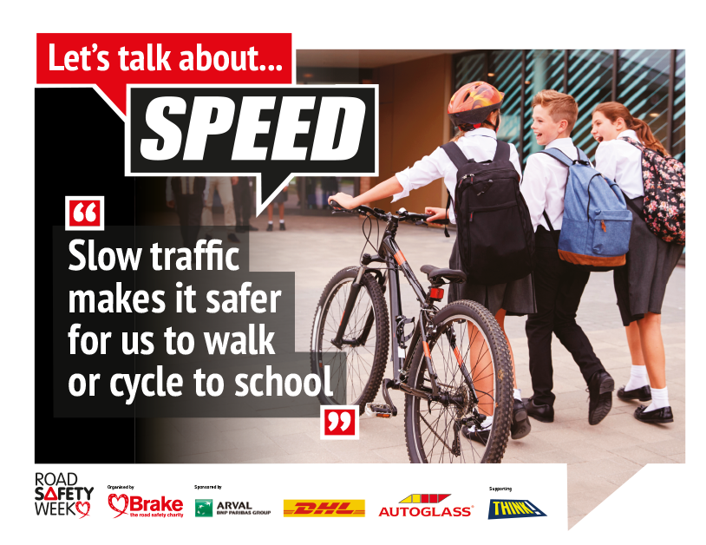
Notes:
Slide 2
Every year, Road Safety Week has a different theme and this year the theme is Let’s talk about speed!
It isn’t a nice thing to hear but every day children are hurt on roads, and some children die because they are hurt so badly.
We want to be able to make safe and healthy journeys whoever we are, and however we travel. We don’t want anyone to get hurt on roads.
So we’re going to be talking about speed and why fast traffic is dangerous.
We’re going to talk about safe places where we can walk and cycle and cross roads.
And we’re going to talk about the different people we share our roads with, and how we can all use roads safely to protect ourselves and each other.
Move to next slide

Slide 3
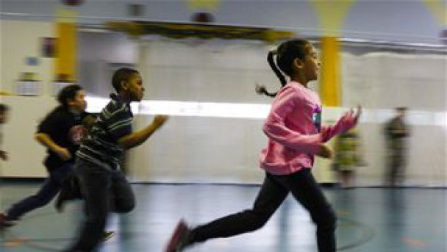
This Photo by Unknown Author is licensed under CC BY
Notes:
Slide 3
When is speed a good thing?
Ask the children for examples of when it’s a good thing to be fast.
Suggestions could include:
Running fast when you want to win a race
Getting something to eat quickly when you’re feeling really hungry
Explain that these are really good examples of when speed is good but sometimes speed can be very dangerous. This is especially true when traffic moves too fast on roads.
Move to next slide

Slide 4
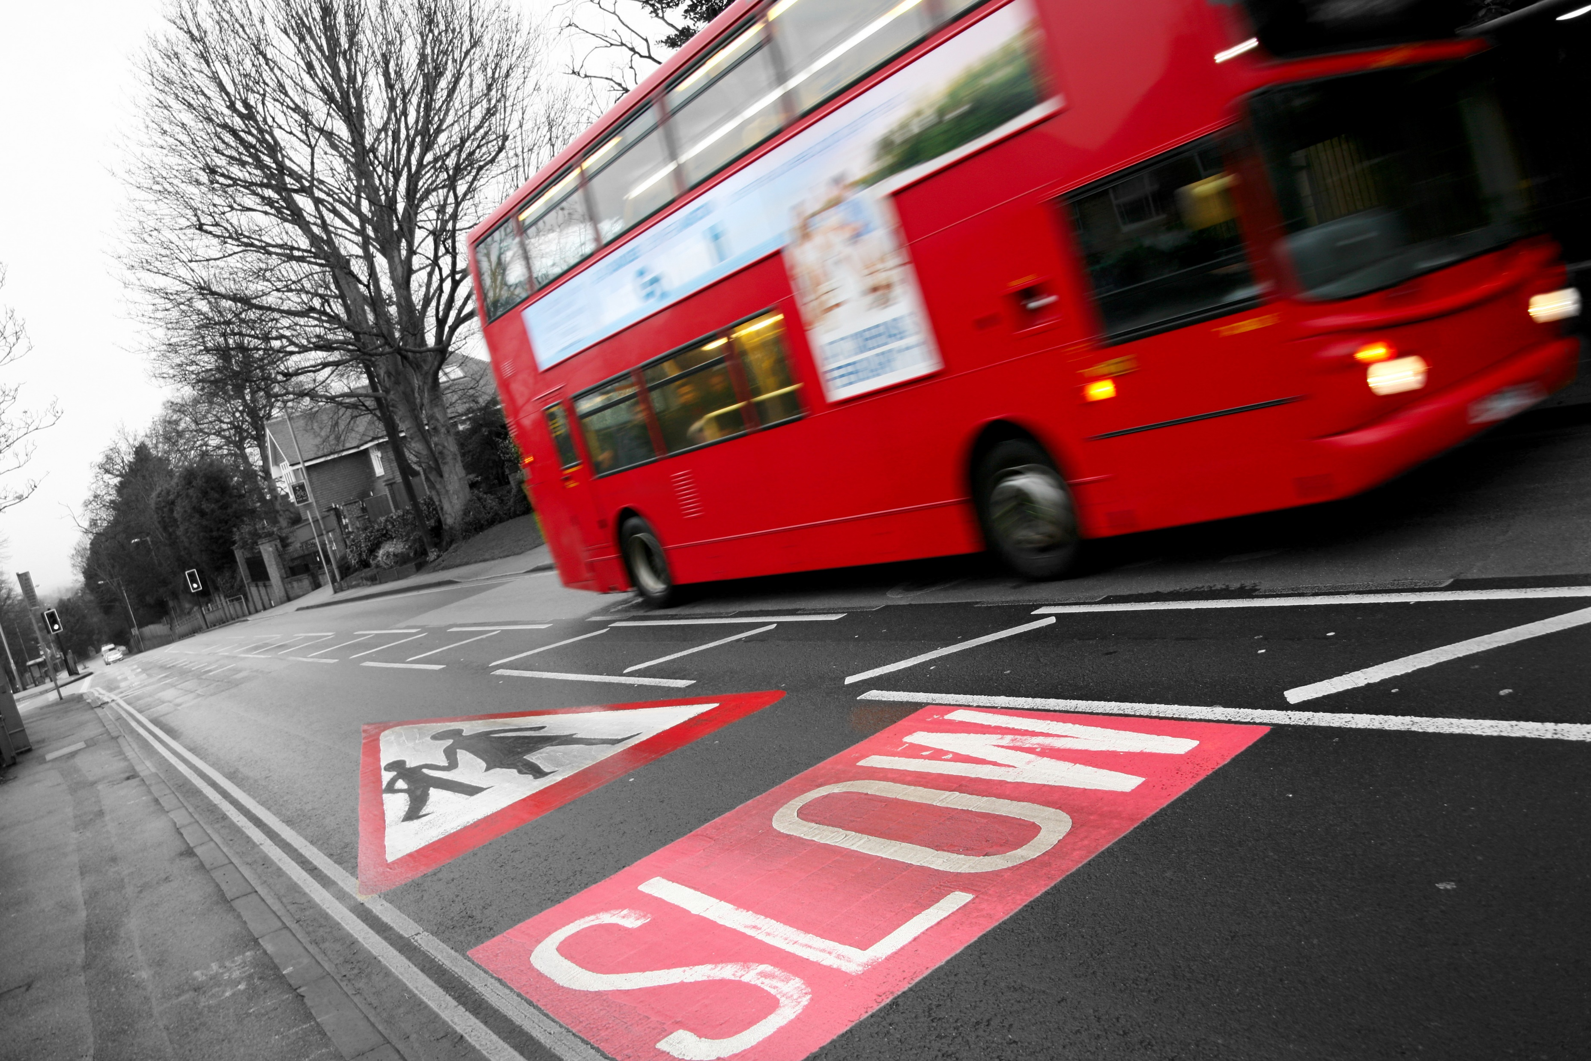
Notes:
Slide 4
Talk about why fast traffic is dangerous.
Most of the time, people move about without being hurt by traffic. But sometimes traffic hurts people.
Sometimes traffic moves too fast. It’s difficult for us to see it coming… and we don’t have time to get out of its way.
Traffic is heavy and made of metal and if it hits us when we are walking or wheeling (riding a bike, scooting, in a wheelchair) it can hurt us very badly.
If a car hits another car, it can hurt the people inside the cars.
It isn’t nice fact to think about people getting killed or hurt in road crashes is it.
One reason that people get hurt on roads is because cars and other vehicles often travel too fast.
Move to next slide

Slide 5
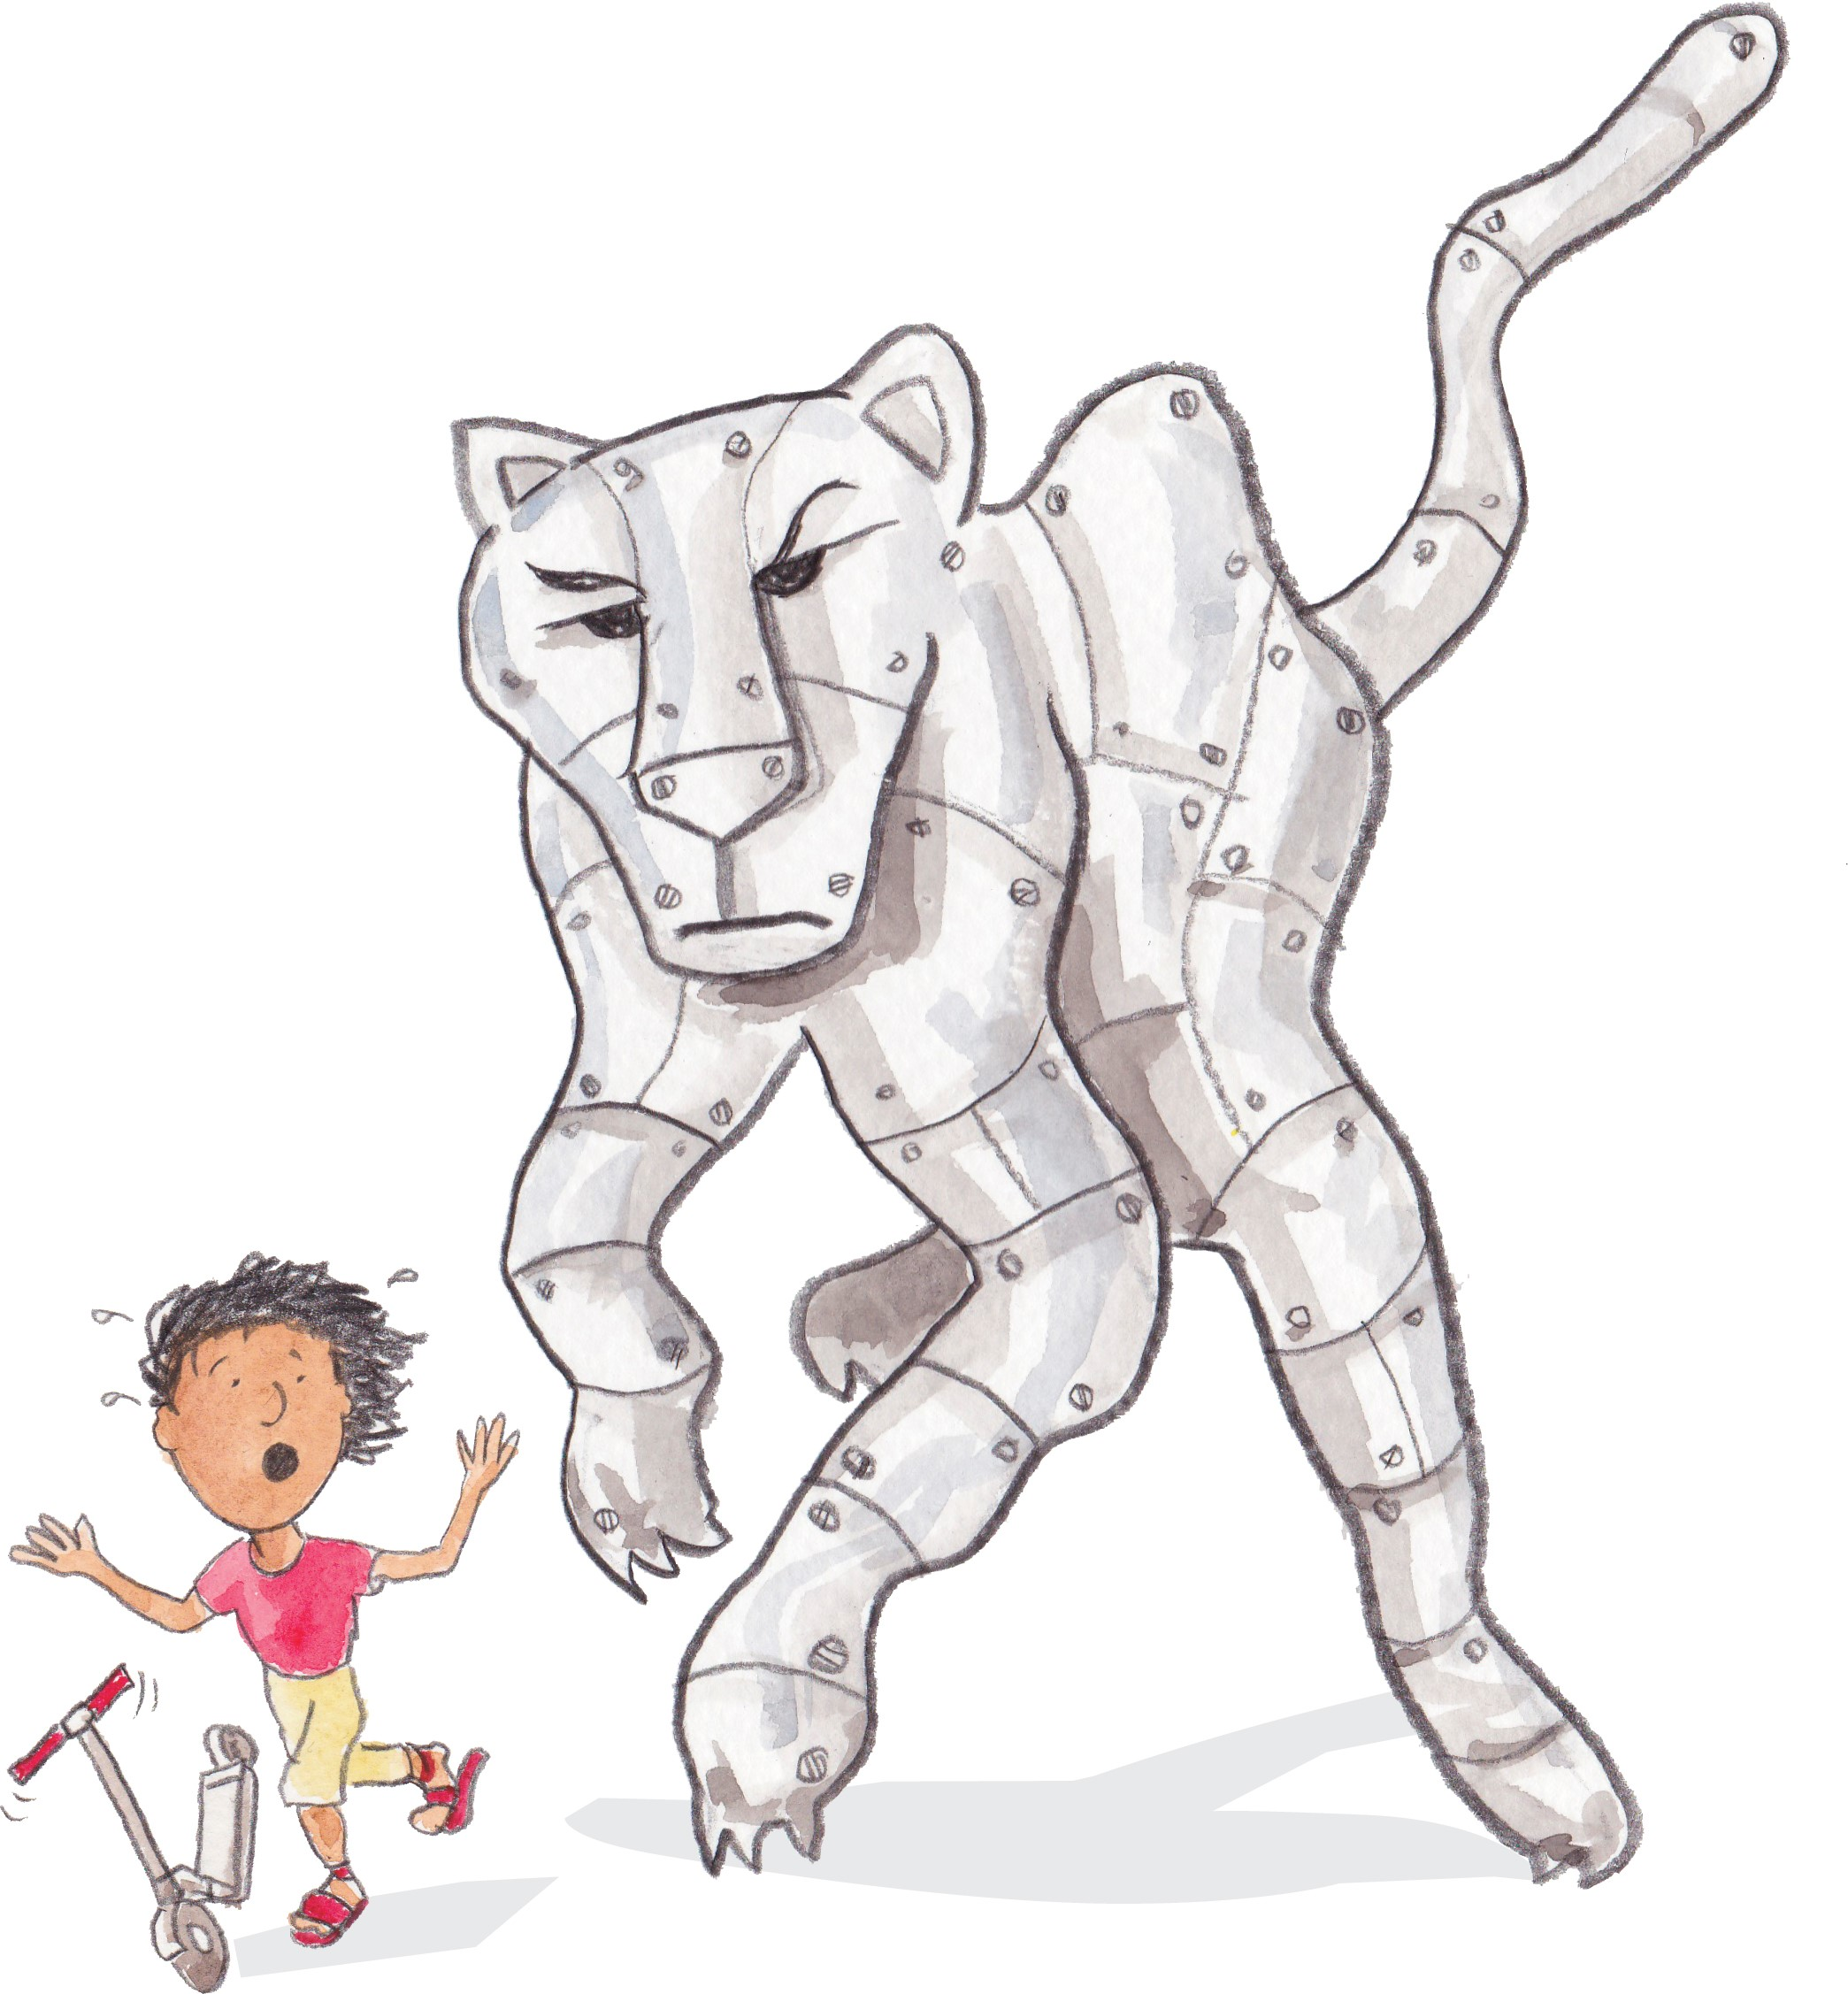
Notes:
Slide 5
An elephant cheetah made of metal
Ask children to think about an elephant. An elephant weighs about the same amount as a car. You wouldn’t want to be hit by an elephant would you?
Now think about a cheetah. A cheetah is the fastest animal on land, and can run at about 68 miles per hour. Cars can travel faster than this.
Now imagine an animal that is as large as an elephant, and made out of hard metal, coming towards you, as fast as a cheetah.
You wouldn’t want to be hit by that would you? It’s not a nice thought is it? But this is what it can be like to be hit by a car.
Even when cars move very slowly, they can hurt someone very badly if they hit them.
Ask the children for ideas about what they might call this animal.
Remember…
Traffic is heavy and hard
If it hits us it can hurt us very badly
Our bodies are soft and get hurt easily
Big vehicles and fast traffic can cause the most harm.
Move to next slide

Slide 6
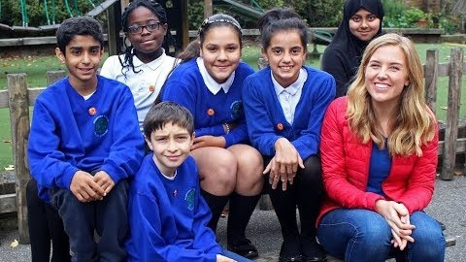
Notes:
Slide 6
Speed Matters with Maddie Moate
Explain that you are going to watch a short film about speed.
Play the ‘Speed Matters with Maddie Moate’ film (5 minutes 3 seconds)
About Speed Matters with Maddie Moate
This short film is aimed at helping children explain how and why they view roads differently and why it is so important for drivers to keep their speed down in places where people live. It gives a simple introduction to kinetic energy and stopping distances, and ends with the children talking about what they would like grown-ups to do to help keep them safe near roads.
The film can be viewed at: https://www.youtube.com/watch?v=ZKrejuEtP5w
You can also embed the film using the following code: <iframe width="560" height="315" src="https://www.youtube.com/embed/ZKrejuEtP5w" frameborder="0" allow="accelerometer; autoplay; clipboard-write; encrypted-media; gyroscope; picture-in-picture" allowfullscreen></iframe>
Move to next slide

Slide 7
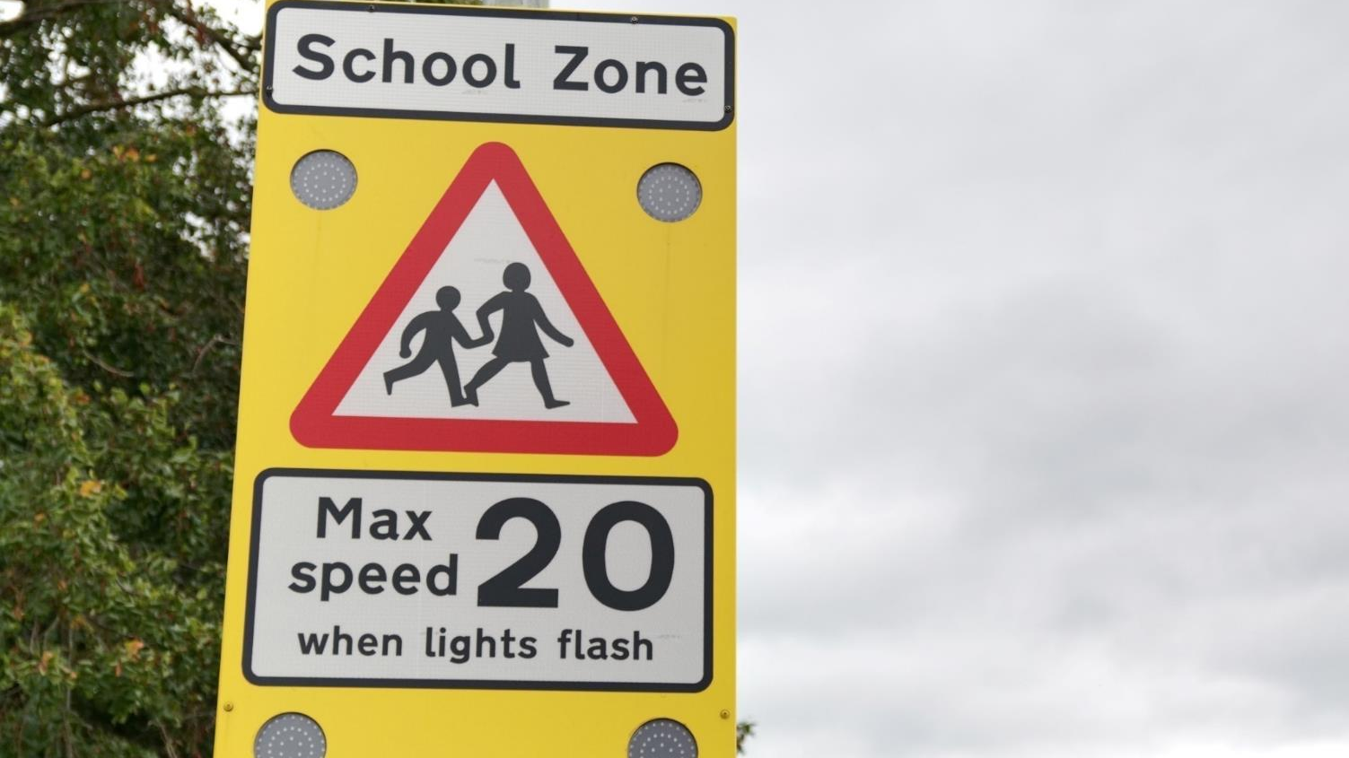
Notes:
Slide 7
[You could replace the picture on this slide with a picture of the roads near your school]
How safe do you feel near roads?
Talk to the children about the traffic around your school or around where they live.
Do they think it travels fast?
Do they feel safe walking or cycling near school/where they live?
Does fast traffic make them feel frightened or worried?
Is the traffic noisy, or smelly? Does it make it dangerous for people to walk and cycle.
Ask for a show of hands for how many children know the speed limit on the road outside your school.
Discuss any good road safety measures around your school, for example, is there a school sign warning drivers to drive more slowly, zig zag lines to prevent cars from parking right outside school, pelican crossings, footbridges or underpasses, 20mph limits, barriers or fences, wide pavements?
Also, discuss any problems around your school, for example if there aren’t any safe place to cross, high speed limit, no pavements
If your school is in a 20mph zone talk about what happens when cars leave the zone and start driving faster. Even though the school is within the 20mph zone, most families don’t live within this zone so traffic will be moving faster in the places where children and families are walking, riding their bikes and playing.

Slide 8
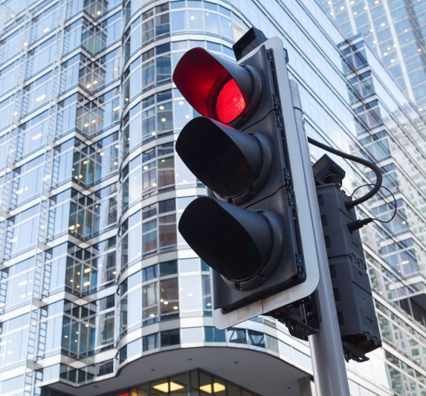
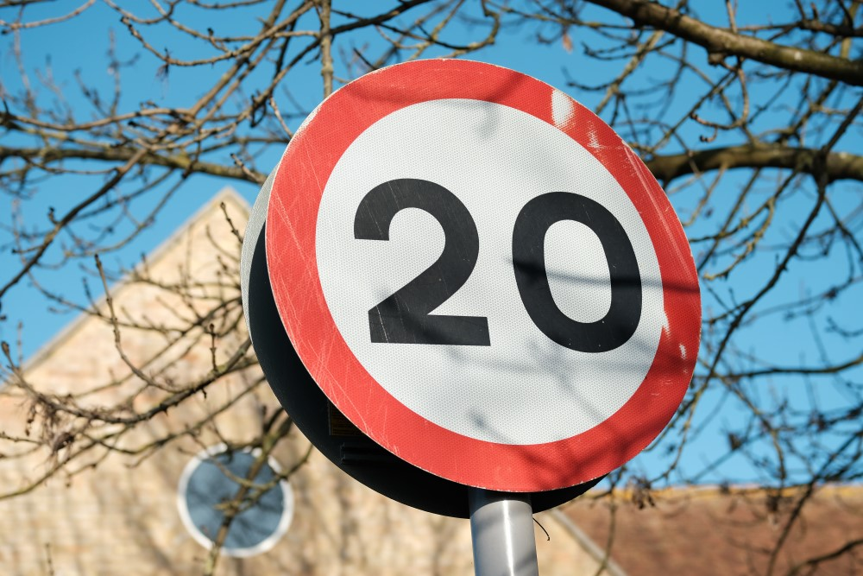
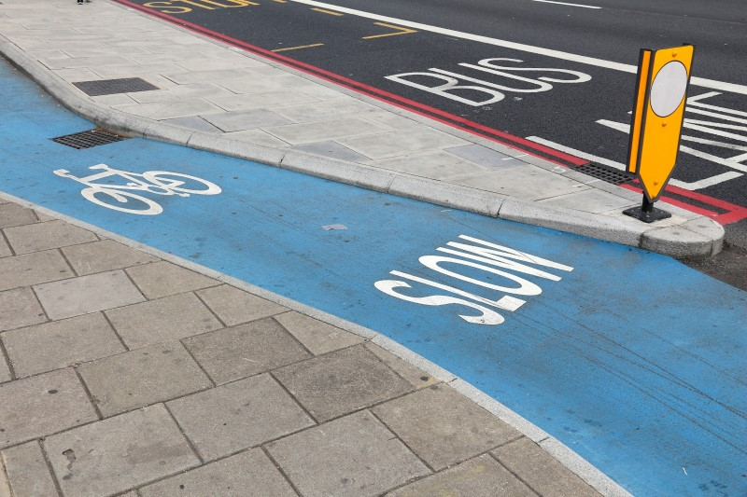
Notes:
Slide 8
What do we need to help us make safe and heathy journeys?
Ask the children for suggestions about what they need to make safe and healthy journeys.
Encourage them to think about how the speed of traffic affects their journeys and about how streets that are designed for people instead of traffic might look.
Suggestions might include
Slow speed limits
Roads designed to slow down traffic (speed bumps and chicanes)
Safe spaces for people to walk and cycle away from traffic
Safe places to cross roads
Remind children that in the film the children talked about how they want slow traffic.
Say that there is a lot that grown ups can do to help make their journeys safer as well.
Move to next slide

Slide 9
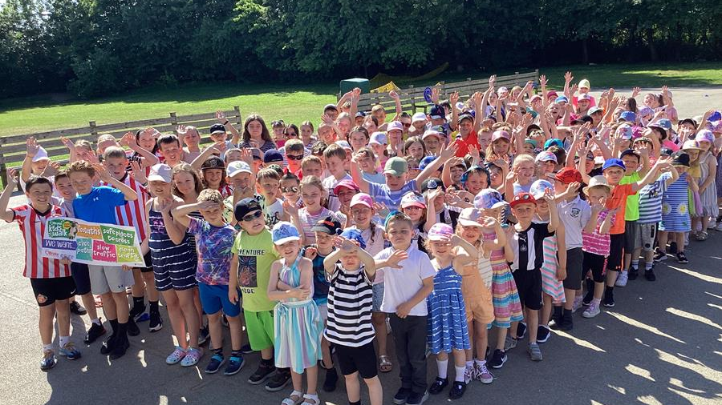
Notes:
Slide 9
Road Safety Week is a campaign for road safety
Thousands of children in hundreds of schools are taking part at the same time
We are campaigning because we want something to change. We want the people who are responsible for roads in our area to make changes so that we can all make safe and healthy journeys. Everyone can campaign for safer roads, it's not just for grown ups.
Brake, the road safety charity, has written an important document called a manifesto to help you ask the people who make decisions about roads near our school to make changes so that our journeys are safe and healthy.
Say that you are going to invite an important visitor to school so that you can present your school's manifesto to them.
You could also:
1. Explain that this is just one way of campaigning for road safety and that lots of children at other schools will be doing the same thing. Brake will also be writing to local newspapers, radio stations and televisions about what is happening.
2. Show the children the manifesto.
3. Explain what will happen when you present your manifesto.
Move to next slide

Slide 10
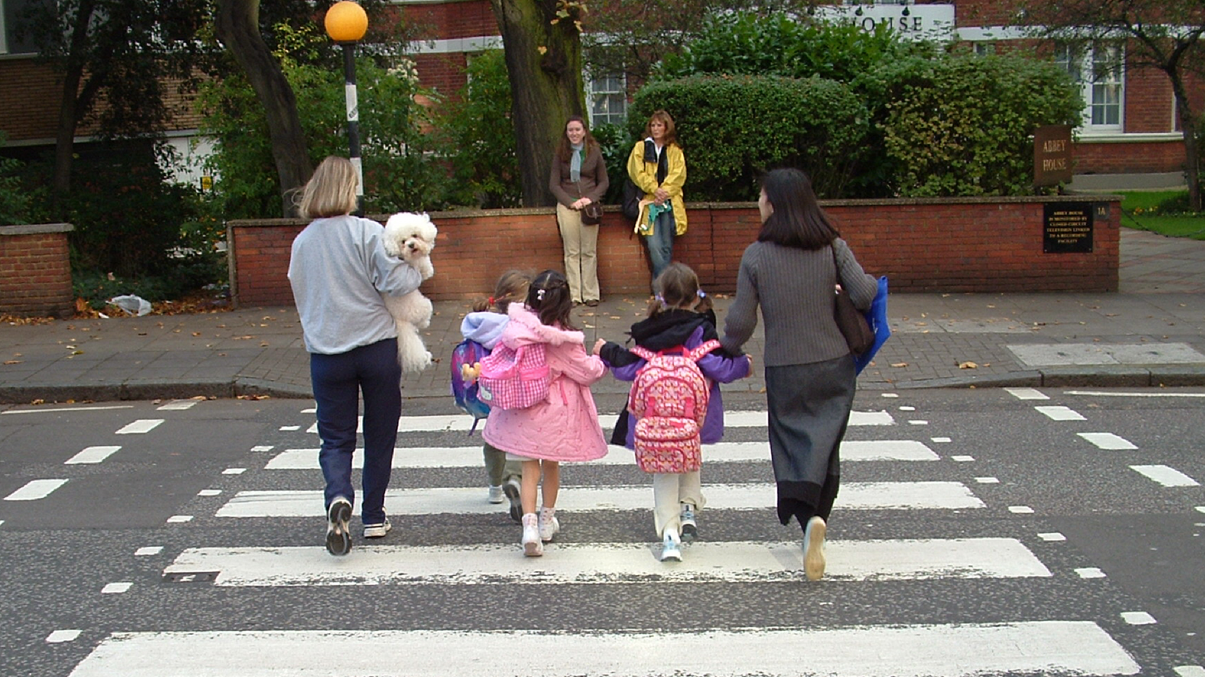
Notes:
Slide 10
Shouting out for road safety
Remember we’re taking part in a campaign called Road Safety Week and talking about road safety.
We’re thinking about how we travel, who we share our roads with and how we can all use roads safely.
Our grown ups can help us too.
Say to younger children that they should always hold hands with a grown-up when walking near roads. They should use safe footpaths away from traffic and always cross roads at safe places with a grown up.
When riding their bikes, they should ride their bike with a grown up on a safe path away from traffic and wear a helmet to protect their head if they fall off.
They should always sit in a special car seat to protect them when travelling by car.
Remind older children that we all share a responsibility to use roads safely, and this includes people who walk, scoot and ride, as well as people who drive.
Say that they shouldn’t use their phone when walking near roads/crossing roads and they should play in safe places away from traffic.
Children can talk to their parents or carers and remind them to drive at safe speeds, especially in areas where people live, work and play; to never use their phone while driving; and to always wear a seat belt.
Talk about any Road Safety Week activities that your school will be doing. There are resources to support all these activities in your Road Safety Week action pack.
For example, you might be:
- Talking about road safety in lessons or group activities
- Using the colouring sheets, activity sheets or postcards and asking children to take them home so they can talk to their parents/carers about important road safety messages.
- Making a display at school out of the artwork they have made during Road Safety Week
- Taking photos using Road Safety Week selfie props (if you have ordered these) and sharing them to shout out for road safety in your community
- Taking part in the #Brake5 Challenge to raise money for Brake.
The #Brake5 Challenge
The #Brake5 Challenge for Road Safety Week is a fundraiser based around the number 5 to raise awareness that five people die on UK roads every day. There is more information about the challenge on the Brake website at www.brake.org.uk/brake5.
Every year, Brake supports more than a thousand families after a road crash. Fundraising for Brake helps our vital work supporting families affected by road crashes and campaigning for safer roads for everyone.
Explain that the children will be learning a lot more about road safety throughout the week
Move to next slide

Slide 11
Notes:
Slide 11
Thank you and summary
Thank children for listening. Remind them that it is Road Safety Week and they can all make a difference to road safety in their communities.
They can be good role models, and use roads safely, and ask grown ups to help keep them safe near roads.
Remind them that they might be talking about road safety in other lessons this week.
If you have a school council ask their representatives to discuss the issues raised in this assembly at their next meeting and to suggest ideas for how they could get more involved in road safety.
END

